Slide 1
UREDMS
Pennsylvania Department of Transportation’s (PennDOT’s)
Utility Relocation Electronic Document Management System
(UREDMS)

Slide 2
PennDOT’s UREDMS
PennDOT’s electronic document management system (EDMS) functions as a virtual filing cabinet. The electronic storage and indexing of these documents allows for easier search, faster retrieval, better revision control, and recovery of valuable office space. UREDMS is part of EDMS that is used for Utility Relocations.

Slide 3
PennDOT’s UREDMS is two parts.
UREDMS Internal (which is intranet based) is for PennDOT’s District and Central Office personnel.
UREDMS External (which is internet based) is for Utility Company personnel.

Slide 4
PennDOT’s UREDMS
The system is used to download and upload main
documents and packages for:
utility relocation agreements
utility relocation permits
utility cost sharing requests
utility real property interest documents
utility relocation plans
utility requests for incorporated utility work

Slide 5
PennDOT’s UREDMS
When users log into the homepage, they have access to:
- different links along the left hand side of the page.
- information about what’s new in the middle of the page.

Slide 6
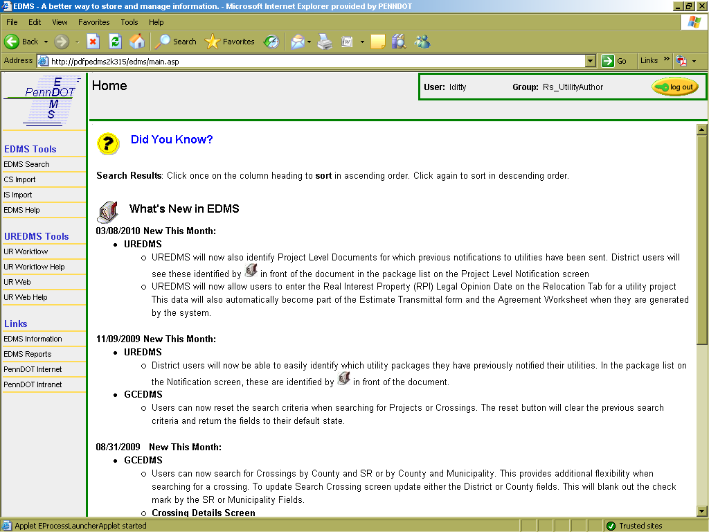
PENNDOT’S (INTERNAL) UREDMS HOMEPAGE

Slide 7
PENNDOT’S (INTERNAL) UREDMS WORK MANAGER
From the work manager users have access to:
- different projects and utility work items for projects.
- links to tabs (i.e. the utility address book and project level notifications).

Slide 8
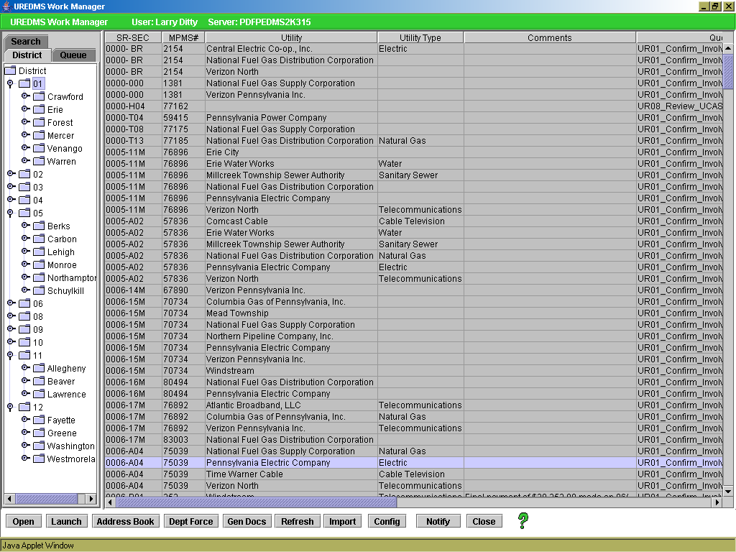
PENNDOT’S (INTERNAL) UREDMS WORK MANAGER SCREEN

Slide 9
PENNDOT’S (EXTERNAL) UREDMS HOMEPAGE
When users log into to the (external) homepage, they have
access to different links along the left hand side of the
page. The links are for:
PennDOT’s Homepage
PennDOT’s Utility Personnel Contact List
PennDOT’s Registration Process
PennDOT’s Project Letting Schedule
UREDMS ETraining

Slide 10
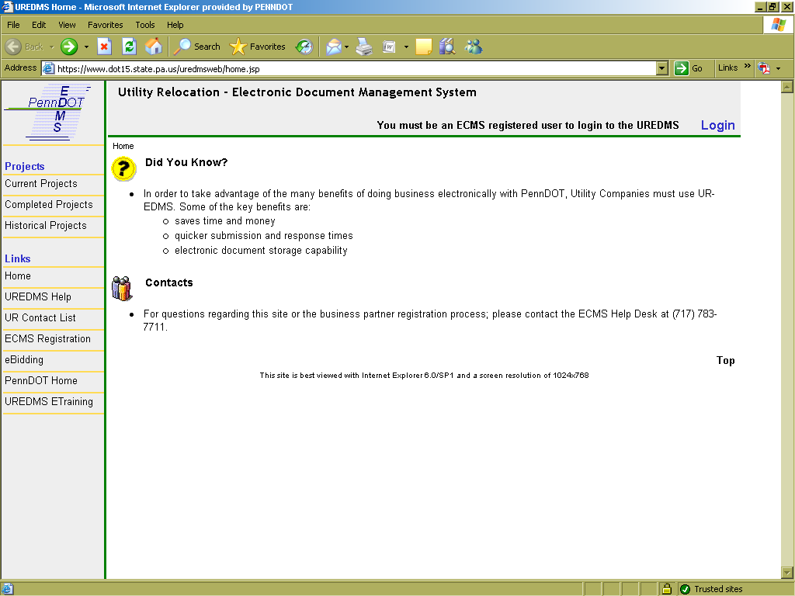
PENNDOT’S (EXTERNAL) UREDMS HOMEPAGE

Slide 11
PENNDOT’S (EXTERNAL) UREDMS CURRENT PROJECT SCREEN
When users click on the current projects link, they have
access to:
- different types of documents and packages to download and upload.
- project specific information.

Slide 12
PENNDOT’S (EXTERNAL) UREDMS CURRENT PROJECT SCREEN

Slide 13
PENNDOT’S UREDMS E-TRAINING
When external users open the e-training, they have
access to a detailed electronic training video that shows
how to use UREDMS.
The complete e-training video is available to everyone and
is about 45 minutes.

Slide 14
UREDMS E-TRAINING ftp://ftp.dot.state.pa.us/transfer/UREDMS/eTraining/

Slide 15
Questions
If there are any questions about PennDOT’s Utility Relocation
Electronic Document Management System, please contact the
PennDOT Central Office Utility Relocation Unit at one of the phone
numbers listed below.
- 717-214-8762
- 717-787-5305
- 717-787-4037

